Slide 1


Martin Zikmund Uno Platform: Your C#/XAML Apps on Mobile & WebAssembly
Tue, 22 Oct | 10:30 AM – 11:20 AM
Panorama Room

Slide 2
Outline
Cross-platform app development
The Uno Platform
Demos
Homework time!

Slide 3













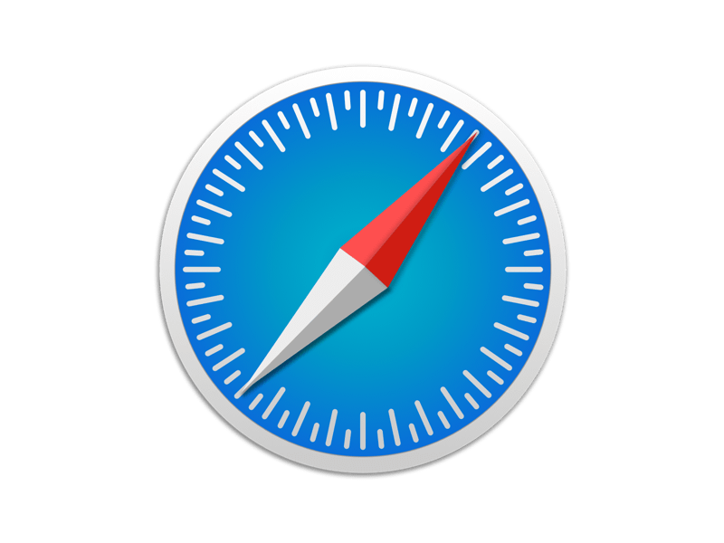
Native app development
Platform
Code
UI

Slide 4
UWP, Xamarin.iOS, Xamarin.Android, Blazor
Platform
Code
UI
Notes:
Can we do better?

Slide 5

Xamarin.Forms
XAML → platform UI controls
Custom XAML dialect
Different naming conventions
Width / WidthRequest
Background / BackgroundColor
Notes:
A solution from .NET world
Originally - quick prototyping, line-of-business apps
Now - also consumer apps
XAML dialect – rendered with platform UI controls
Intent – create UI familiar to users of each platform
Simplified XAML
Only partial support for styling, templating
Different naming conventions vs. UWP and WPF
Background is not a brush – no gradient, etc.
HorizontalAlignment – HorizontalOptions
Copyright infringement story
Mostly for UI, for other common features Xamarin.Essentials
Need to learn new API on top of existing platform skills

Slide 6
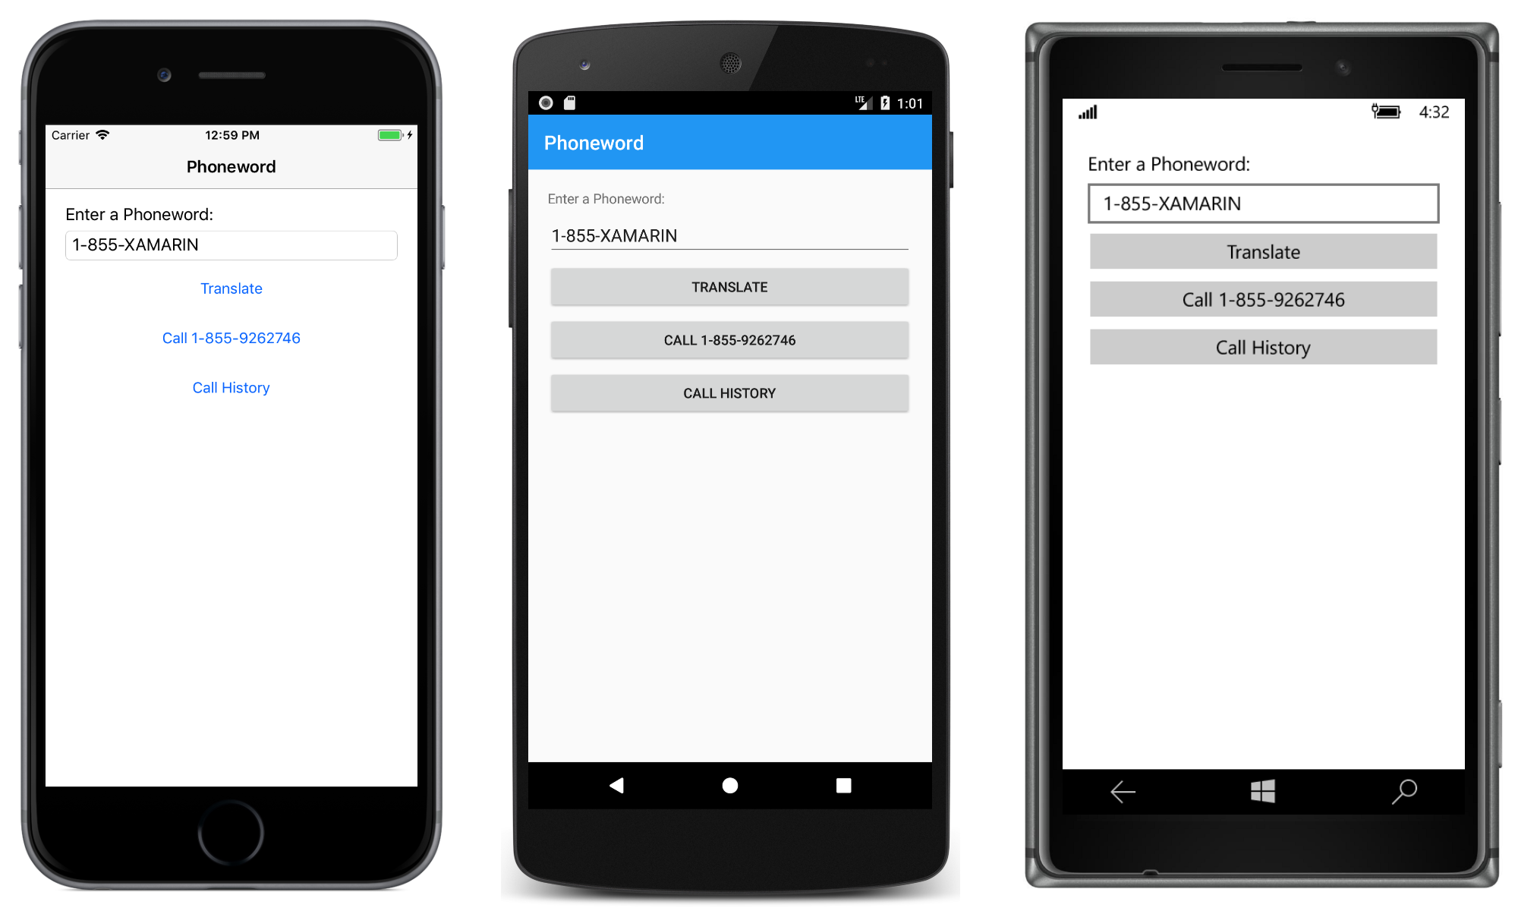
Xamarin.Forms UI comparison
Notes:
- Example of classic Xamarin.Forms UI side-by-side
Each platform looks differently
Hard to unify the design, consistency
Hard company branding
Often need to use renderers to fix oddities

Slide 7
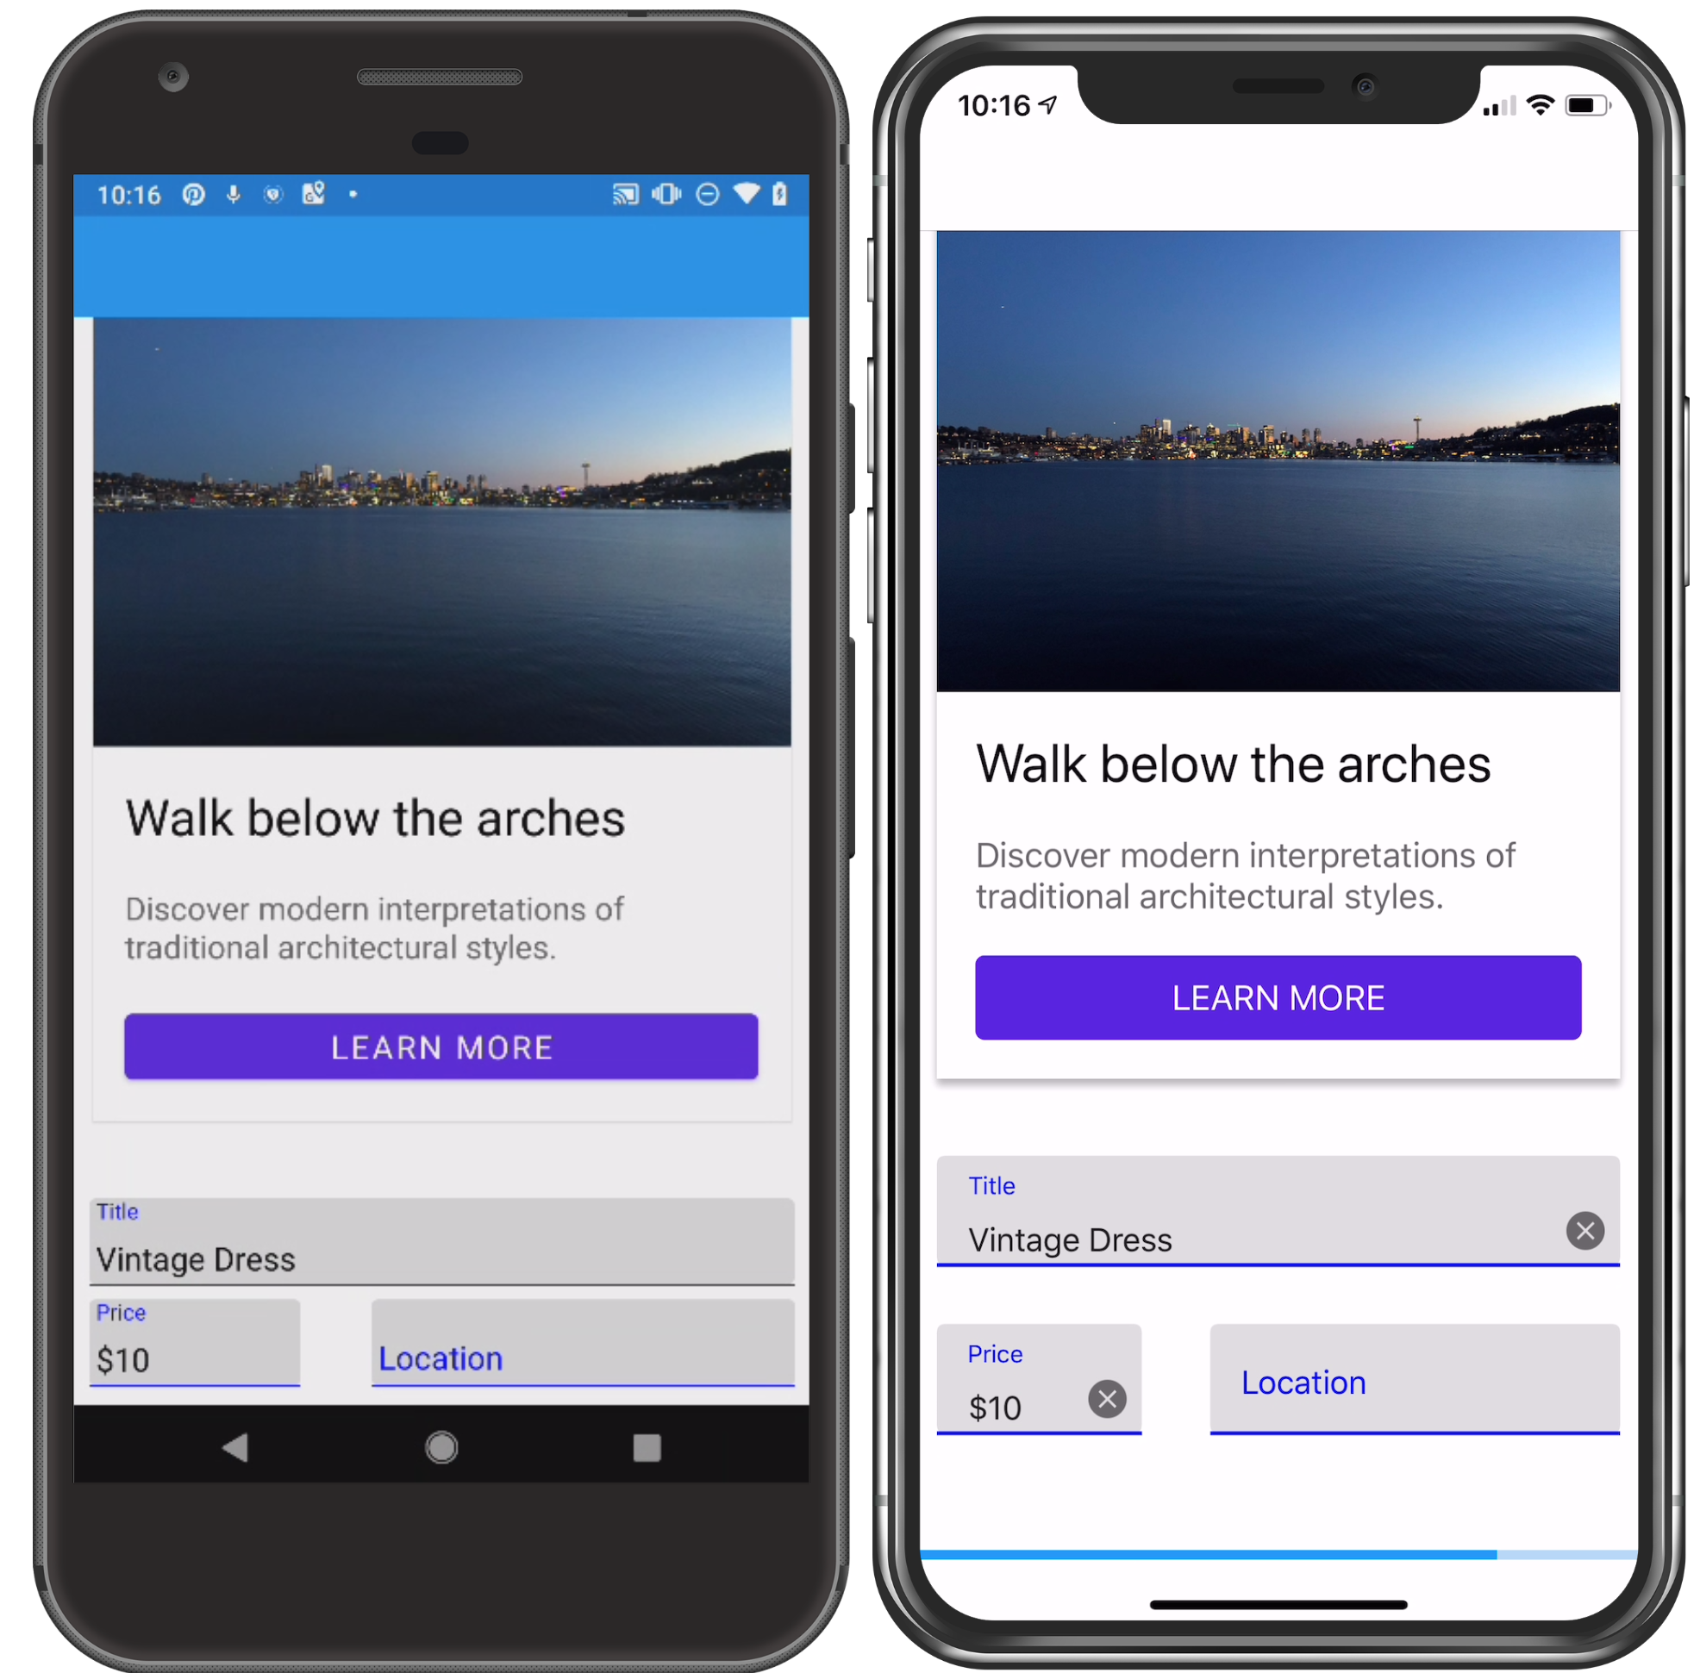
Xamarin.Forms Shell/Material design
Notes:
Team recognized the difficulties of building a branded app
Shell and material visual = solution
Still some differences, inconsistencies
No UWP support (in progress, but not officially supported)
UWP is key for smooth debugging and dev loop

Slide 8
Xamarin.Forms
Platform
Code
UI
*
???
* Xamarin.Forms dialect
Notes:
We have lost a key component – the web
XF does not have a WebAssembly story yet

Slide 9
Uno Platform
Free, open source (Apache 2.0).
1 codebase → mobile, desktop and WebAssembly.
Port of Universal Windows Platform (UWP) API and XAML – goal is 1:1 compatibility.
https://platform.uno/
Notes:
Developed by nventive, based in Montreal, Canada
Open sourced in May 2018
The only platform for building single-codebase native mobile, desktop and WebAssembly apps with C# & XAML.

Slide 10
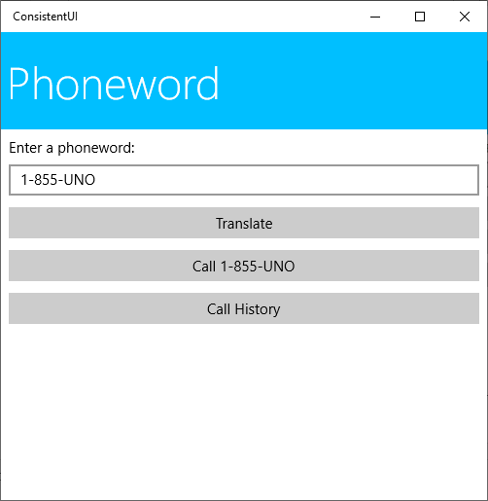
Uno Platform UI comparison
<Grid>
<Border Background="DeepSkyBlue">
<TextBlock Text="Phoneword" />
</Border>
<StackPanel Grid.Row="1">
<TextBox Header="Enter a phoneword:"
Text="1-855-UNO" />
<Button Content="Translate" />
<Button Content="Call 1-855-UNO" />
<Button Content="Call History" />
</StackPanel>
</Grid>
UWP

Slide 11

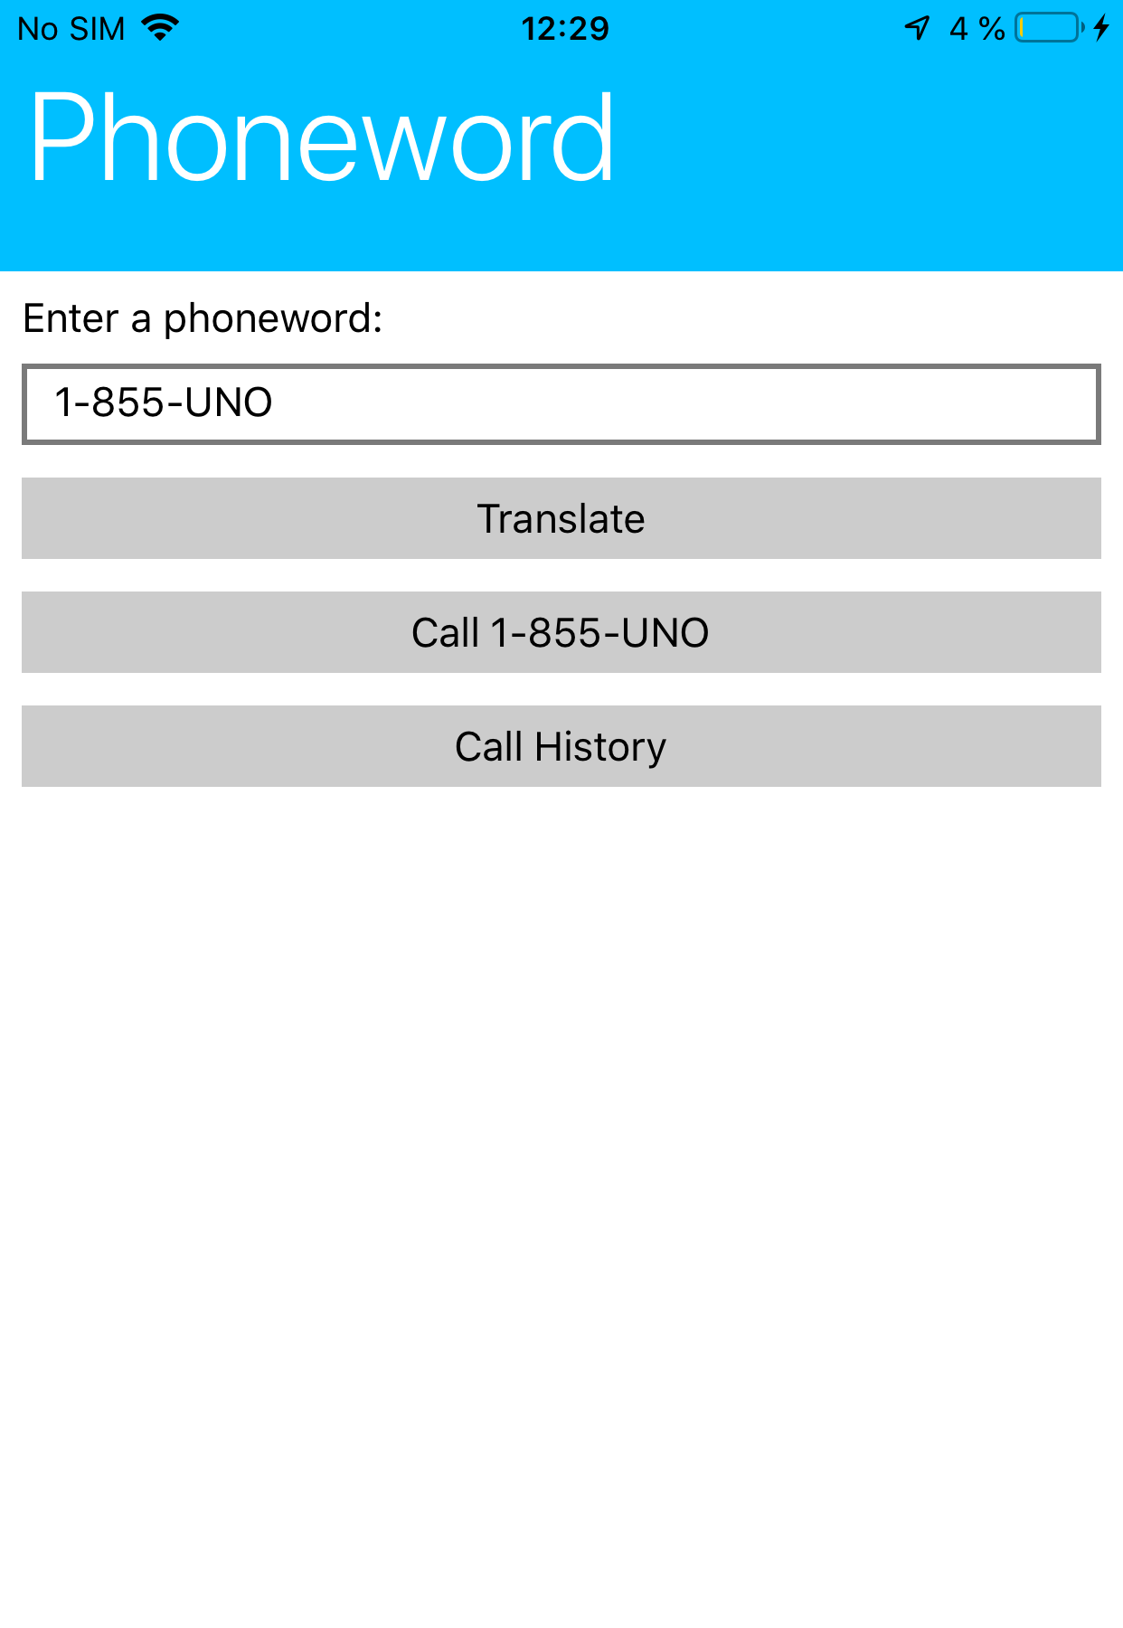
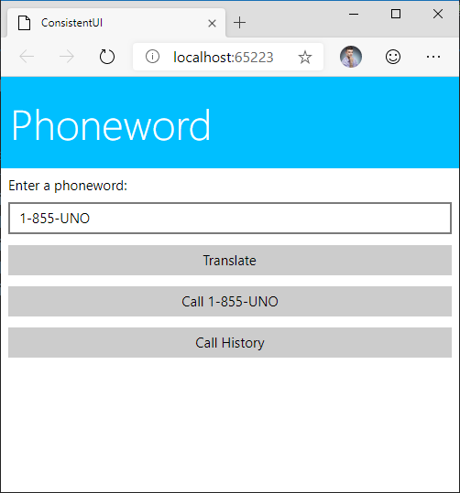
Uno Platform UI comparison
Android
iOS
WebAssembly

Slide 12

Uno Platform
Platform
Code
UI
XAML

Slide 13
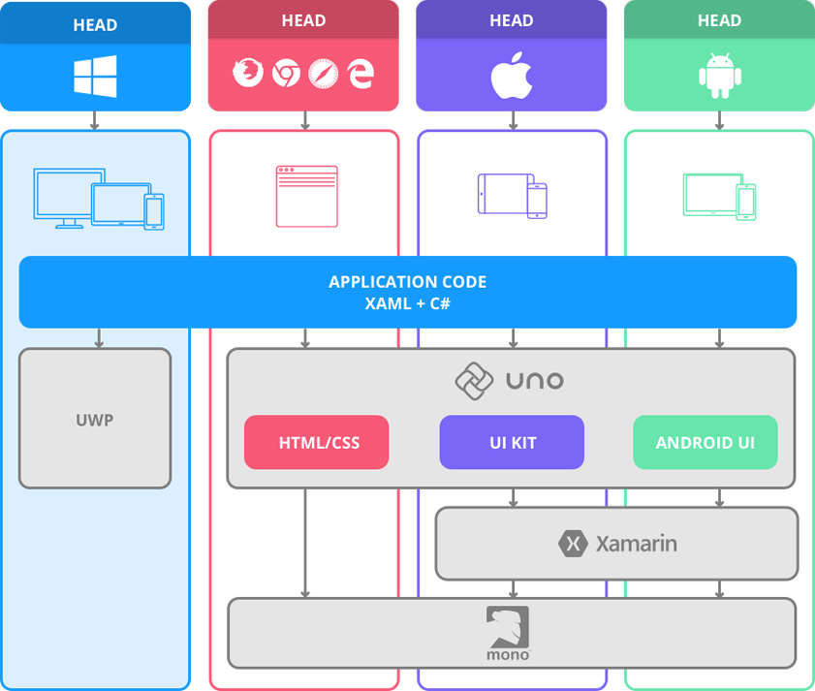
Notes:
- So how does Uno Platform do this?
- Brief look at architecture
UWP runs directly against Windows UWP API
Full support for Visual Studio tooling
WASM head
Render using HTML, CSS
Run on Mono
Android, iOS
Native UI libraries (UIKit, Android UI)
Xamarin for native API bindings
Mono
Result – all platforms – native performance
Explain the difference between Xamarin.Forms XAML and Uno XAML
Not limited to lowest common denominator – full templatability
Button.Content vs Button.Text

Slide 14
Uno namespaces = UWP namespaces
UWP
Uno Platform
Windows.UI.Xaml.Controls.Button
Windows.UI.Xaml.Controls.Border
Windows.UI.Xaml.Controls.Button
Windows.UI.Xaml.Controls.Border
Compiling for:
UWP – Windows.Foundation.UniversalApiContract
Android, iOS, WASM – Uno, Uno.UI
Notes:
Works underfully with the shared project, which just gets “included” as assets into the platform specific projects.

Slide 15




API to Native Mapping
TextBlock
Settings Storage
UILabel
NSUserDefaults
TextView
SharedPreferences
HtmlParagraph (<p>)
IndexedDB
UI
UI
UI
UI
Platform API
Platform API
Platform API
Platform API
Notes:
UWP controls and APIs map to native controls and APIs on every platform
Mapping is not direct (as opposed to Xamarin.Forms)
Support for styling and templates
More freedom in styling and possibility to add features not available on the native control
Goal is to be able to just copy-paste a UWP control template and make it look the same as on Windows
Each platform is implemented using platform specific APIs, but you don’t need to know about them – you just use the UWP interface and its all done for you

Slide 16

Xamarin.Forms XAML vs Uno/UWP XAML
Example: Creating a “image button”
Xamarin.Forms
<Button Text="?" />
Uno/UWP XAML
<Button>
<Button.Content>
<Image Source="Hello.png" />
</Button.Content>
</Button>
System.Object
System.String
Notes:
On XF, a Button has just a Text, which is a string. You cannot put an image into a string.
You will have to reach for a third party library
You will have to write platform-specific renderers
In Uno XAML, button has a Content property, which can host any content you can imagine

Slide 17

Demo Hello, Uno Platform
Notes:
Here show a pre-built demo app which has UWP UI with styling and stuff and then suddenly run the same on Android and iOS.

Slide 18
Demo XAML Hot Reload
https://www.youtube.com/watch?v=_0RXP4ESxkQ
Notes:
Here show the Uno Calculator.
Tell story about the Windows calculator bug reported to Uno.

Slide 19
Demo Calculator
Notes:
Here show the Uno Calculator.
Tell story about the Windows calculator bug reported to Uno.

Slide 20




Uno Calc
Android
https://bit.ly/2VPaViI
iOS
bit.ly/2VPaViI
WASM
calculator.platform.uno/

Slide 21
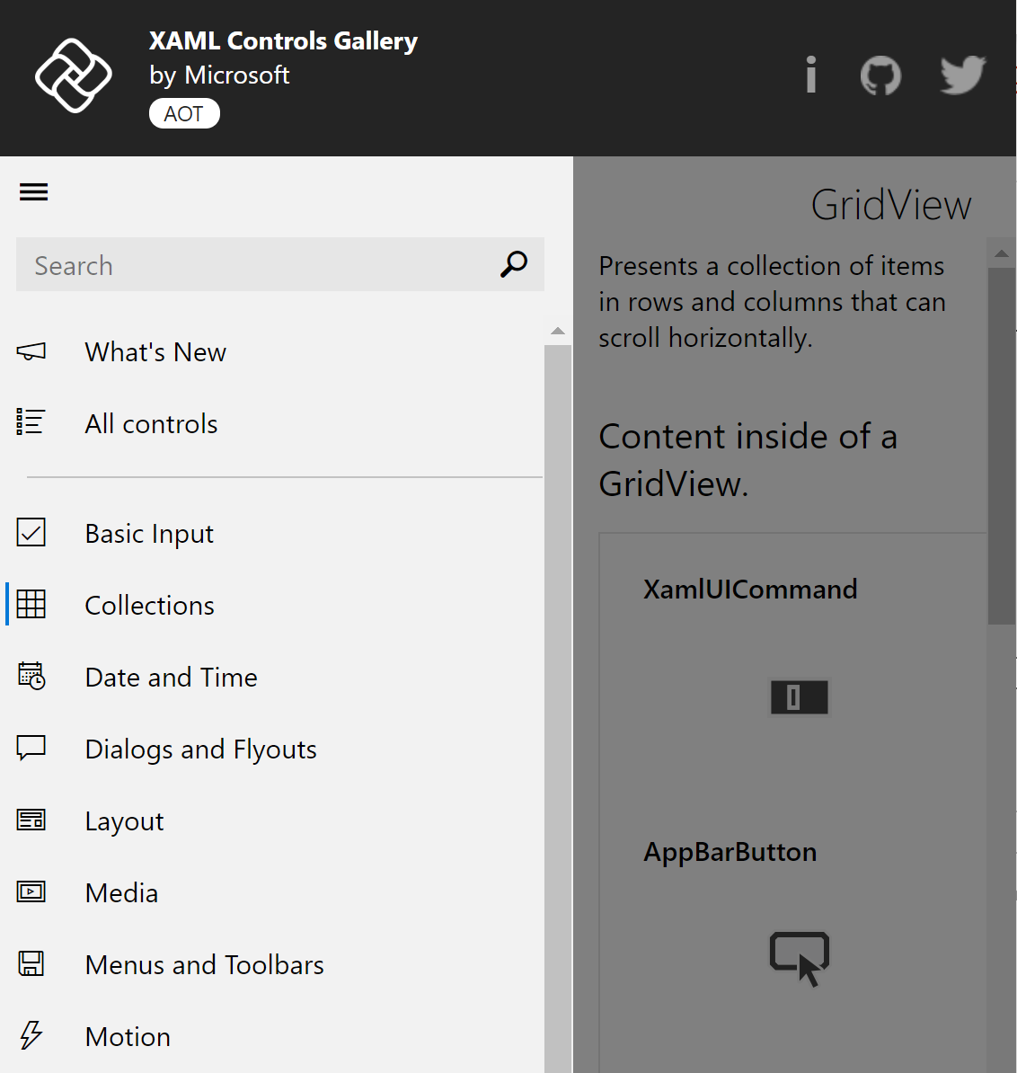
Uno UI
Control/Data templating, styling
Animations, Adaptive Triggers
Data binding
Native Controls embedding
Notes:
Full compatibility with UWP XAML
Includes advanced features
Controls are templatable
Conditional XAML to tailor to specific platforms

Slide 22

Uno – UI? Not only!
And many more!
Notes:
Uno is not only about UI
No need to learn a new 3rd party library, many things out of the box and support keeps growing

Slide 23







Libraries
Direct support
ReactiveUI
Lottie (https://lottie.platform.uno/)
SkiaSharp (https://skiasharp-wasm.platform.uno/)
MvvmCross (soon)
Syncfusion (announced)
Telerik (under consideration)
Forks
Windows Community Toolkit
WindowsStateTriggers
Notes:
Uno supports 3rd party libraries
Forks of many OSS projects
Uno is basically a new target platform

Slide 24
Uno Platform WebAssembly Renderers for Xamarin.Forms
Bringing WASM support to Xamarin.Forms
Depends on UWP support in Xamarin.Forms
UWP renderers → Uno on WASM
> dotnet new wasmxfhead

Slide 25
Demo Uno Platform WebAssembly Renderers for Xamarin.Forms
Notes:
Here show a pre-built demo app which has UWP UI with styling and stuff and then suddenly run the same on Android and iOS.

Slide 26
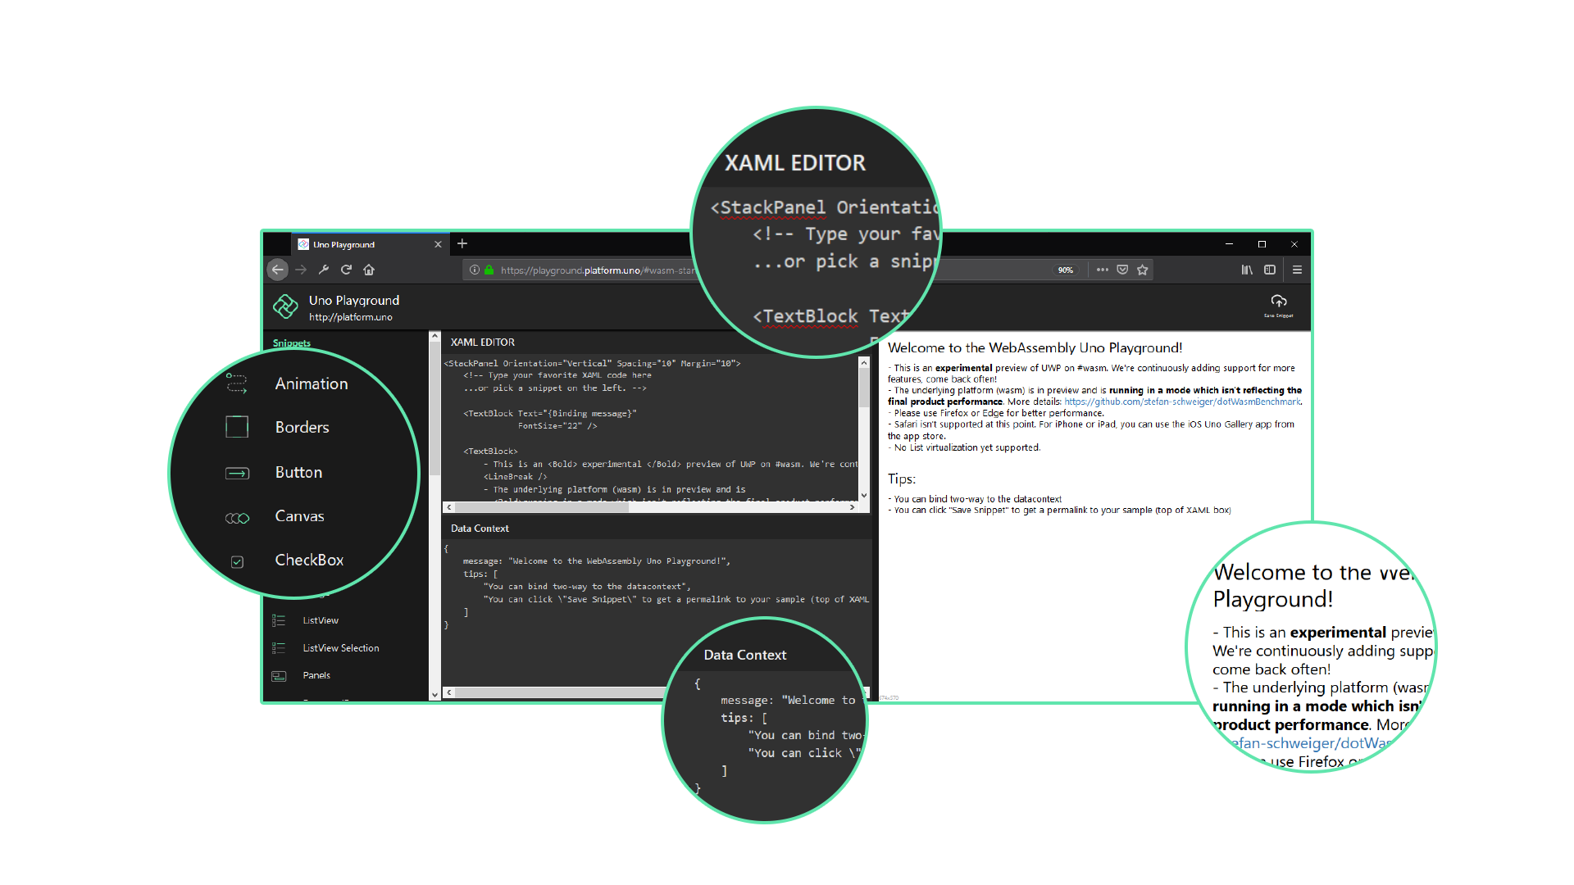


Uno Platform Playground
Uno Gallery App
https://playground.platform.uno
Built with Uno to demo Uno
XAML EDITOR
SAMPLES LIST
XAML VISUALIZER
DATACONTEXT EDITOR & VISUALIZER
Notes:
Say that this is an app made using Uno to demo Uno

Slide 27

“Homework time”!
Submit feedback
&
Contribute
Create app with Uno
https://github.com/unoplatform/Uno
https://platform.uno/
https://bit.do/uno-contribute-101
https://bit.do/first-uno-app
Notes:
Add link to contributing to Uno blogposts

Slide 28






Resources
https://github.com/MartinZikmund/uno-devreach-2019
https://blog.mzikmund.com/
@mzikmunddev
@mzikmunddev
mzikmunddev
https://github.com/MartinZikmund/
Notes:
Add Link to Uno Medium blog
I wish you all a great day and I look forward to see what you create with Uno Platform!

Slide 29


Session Feedback Your Time & Opinion is Valued
https://www.telerik.com/devreach/day1feedback

Slide 30

What’s coming?
Uno Platform 2.0
WinUI 3.0 alignment
Ecosystem growth
WebAssembly
Threading support
Profile Guided AOT
More backends (macOS, Skia)
UnoConf Developer Conference Montreal September 23-25, 2020

Slide 31
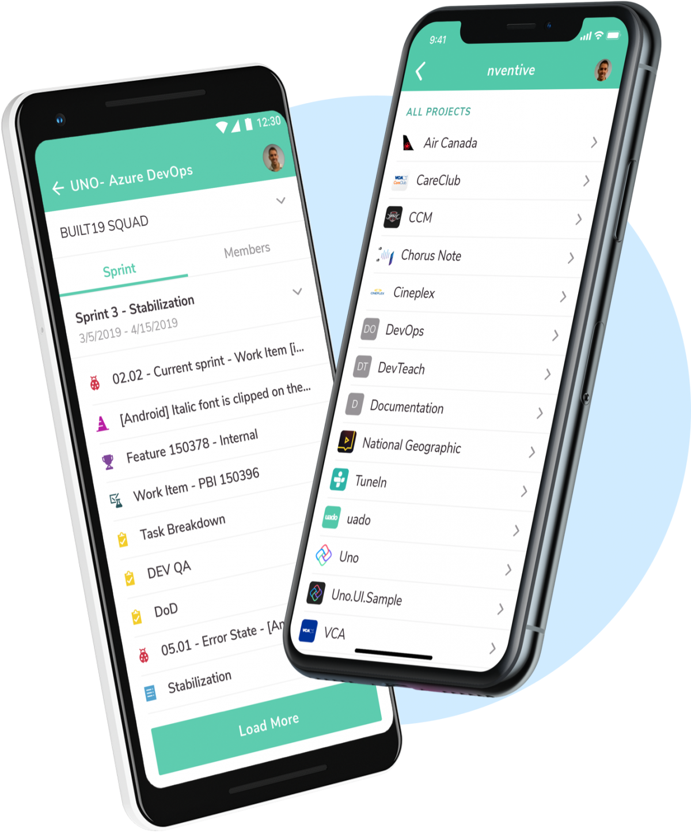
The Uno Philosophy
Leverage existing tools
Create rich, responsive apps
Let views do views
Native interoperability
Performance is a feature
Notes:
Build on shoulders of giants
Start with UWP app – do not care you are building cross-platform app
Use all Visual Studio tools
Rich animations, rich UI – UX matters
MVVM
Embed native controls in XAML, use platform-specific APIs, interop with Xamarin.Forms possible as well
Users do care about performance

Slide 32


Uno XAML Hot Reload (preview)
Full and partial XAML reload
Supports iOS, Android and WebAssembly
Upcoming features
XAML VS Language services integration
Integrated error reporting
Editing of resources and templates

Slide 33
Demo XAML Hot Reload
Notes:
Here show a pre-built demo app which has UWP UI with styling and stuff and then suddenly run the same on Android and iOS.

Slide 34
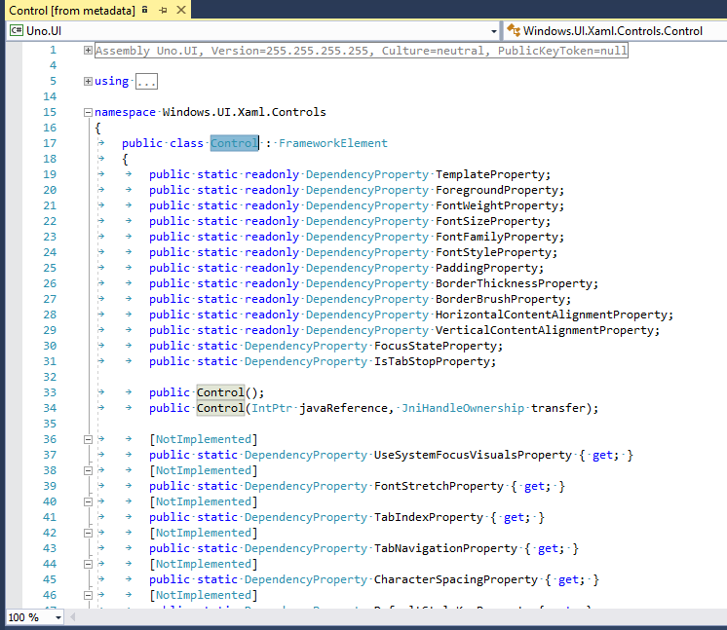
How does it work?
All UWP types and members are exposed by Uno.UI
Subset implemented by Uno
Any existing UWP C# code should compile with Uno
Non-implemented features will throw an exception at runtime
Non-implemented types, properties etc. are marked with the [NotImplemented] attribute and will show a warning in VS (Roslyn analyzer)

Slide 35


Uno Platform Prerequisites
Visual Studio 2019 for Windows
Universal Windows Platform
Mobile development with .NET
ASP.NET and Web
macOS for iOS build host
Uno Platform Solution Templates Visual Studio extension

Slide 36

Cross-platform app development
Notes:
The topic of my talk is cross-platform app development.
Challenging
Many approaches and frameworks
Ongoing search for ideal solution

Slide 37
Xamarin.Forms
Platform | Code | UI
Windows | C# | XAML*
Android
iOS
Web
* Xamarin.Forms dialect
Notes:
Situation with Xamarin.Forms
Shared logic, shared UI, albeit with limited dialect of XAML
Windows support limited
Web story non-existent (yet)

Slide 38
Native development
Platform | Code | UI
Windows | C# | XAML
Android | Kotlin | AXML
iOS | Swift | Swift UI
Web | JavaScript | HTML & CSS
Notes:
Traditional approach – native app for each OS
Requires a team of diverse developers proficient in each technology stack
Time to develop – O(N)
Time to fix bugs – O(N)
Time to develop new features – O(N)
No code-sharing

Slide 39
Uno Platform
Platform | Code | UI
Windows | C# | XAML
Android
iOS
Web
Notes:
Traditional approach – native app for each OS
Requires a team of diverse developers proficient in each technology stack
Time to develop – O(N)
Time to fix bugs – O(N)
Time to develop new features – O(N)
No code-sharing

Slide 40
UWP, Xamarin.iOS, Xamarin.Android, Blazor
Platform | Code | UI
Windows | C# | XAML
Android |  | AXML
iOS |  | Swift UI
Web |  | HTML & CSS
Notes:
Traditional approach – native app for each OS
Requires a team of diverse developers proficient in each technology stack
Time to develop – O(N)
Time to fix bugs – O(N)
Time to develop new features – O(N)
No code-sharing

Slide 41

Supported platforms
UWP
native
Android
stable
iOS
stable
Uno
WebAssembly
preview
macOS
very preview
Notes:
WebAssembly highlighted - support makes Uno unique

Slide 42
Uno Platform – Your apps, everywhere
Martin Zikmund
@mzikmunddev
Notes:
Good morning everyone! I hope you enjoyed the keynote and started your DevReach conference on a high note. My name is Martin Zikmund and I would like to tell you how you can get your apps to all platforms you can imagine with the Uno Platform.

